Slide 1
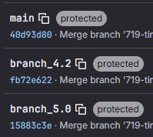
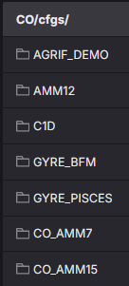

Proposition for structure
Mirror the NEMO src project
CO developments in version branches now tied to NEMO version: CO10 -> 4.2.2, CO11 -> 5.0.1
AMM7 and AMM15 will be combined into a single branch, first CO10.
Versions to be released and tagged (same as before). CO10.beta.0 will be released to match AMM15 CO10.0.
Ideally previous versions/branches are protected so that there is only a single active development branch. Question: what development is left/planned for 4.2.2 AMM15 or AMM7?
Development cycle to match NEMO/GOSI (as Daley presented)
Mirrored
Development
CO11
Combined

